Slide 1




KIIT Deemed to be University, School of Computer Engineering
HealChain
Search
HealChain –
A Blockchain Based Electronic Health Record
Presented by:
Saurav Ranjan - 2229157
Snehil Pandey - 2229179
Shubham Singh - 2229202
Vivek Kumar - 2229203
Aishwarya Ranjan - 2229207
Akshay Singh -2229209
UNDER THE GUIDANCE OF
GUIDE NAME: Sourav Kumar Giri
Date: 07 / 04 / 2025
1

Slide 2

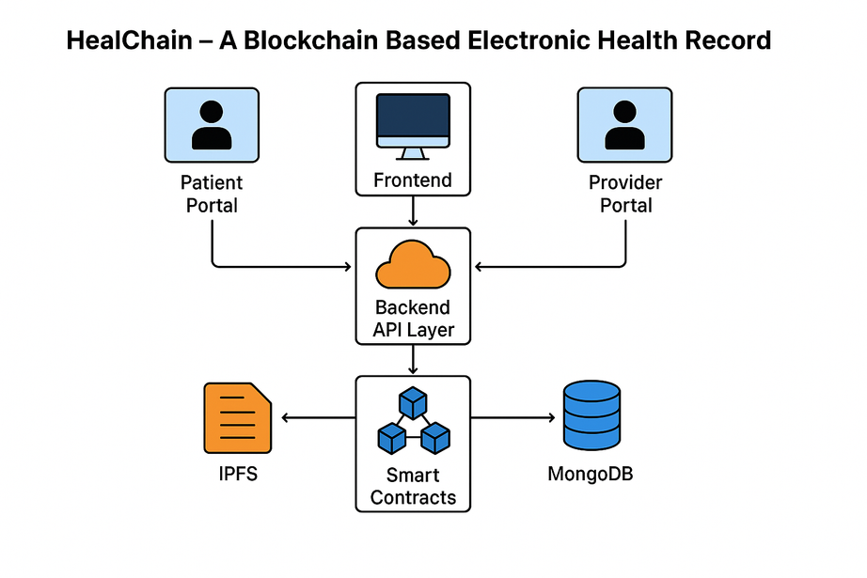
HealChain
Project
Overview
Objective:
Develop a secure, decentralized, patient-controlled Electronic Health Record (EHR) system.
Key Technologies:
Ethereum Smart Contracts
IPFS for decentralized file storage
MongoDB for metadata management
Outcome: A scalable system that enhances data integrity, transparency, and user-controlled access.
2

Slide 3
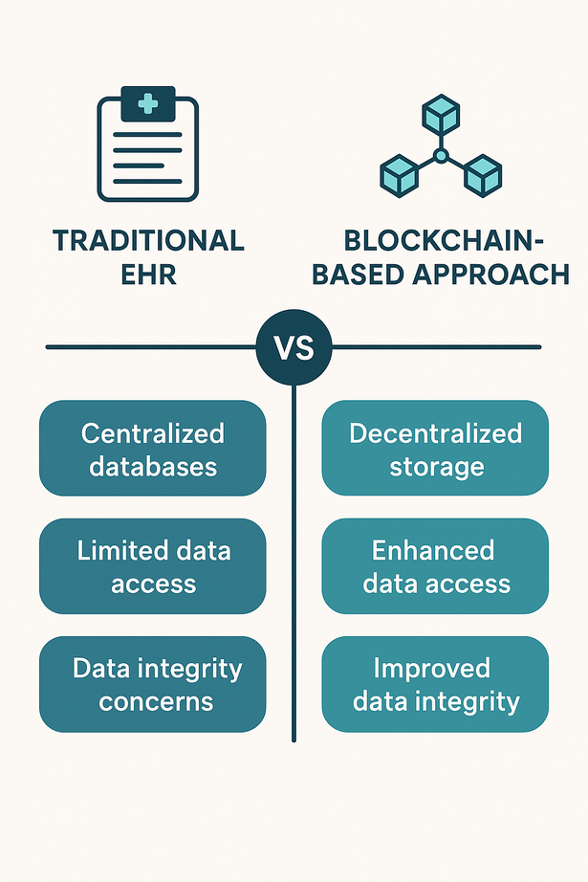
HealChain
Background
& Motivation
Healthcare Challenges:
Fragmented data silos
Centralized control and security breaches
Lack of interoperability
Blockchain Promise:
Decentralized architecture for tamper-proof data
Enhanced patient control over their records
Inspiration: Practical applications like KIIT University’s digitization efforts at KIMS Hospital.
3

Slide 4
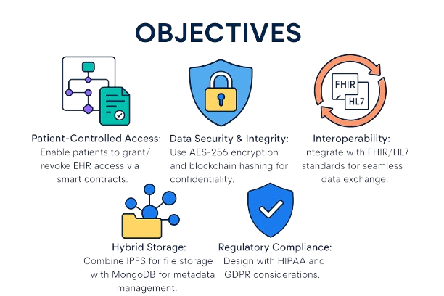
HealChain
Patient-Controlled Access
Enable patients to grant/revoke EHR access via smart contracts.
Data Security & Integrity: Use AES-256 encryption and blockchain hashing for confidentiality.
Interoperability: Integrate with FHIR/HL7 standards for seamless data exchange.
Project
Objectives
Regulatory Compliance: Design with HIPAA and GDPR considerations.
Hybrid Storage:
Combine IPFS for file storage with MongoDB for metadata management.
4

Slide 5
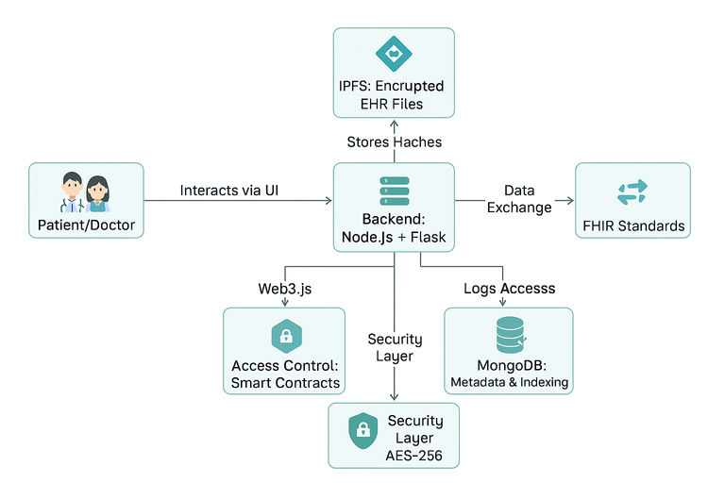
Frontend Development:
Built with React.js for user portals (patient and healthcare provider interfaces).
Features: Login/dashboard, access management, EHR upload/download.
Backend Development:
Node.js and Express.js managing business logic and API routing.
Integrates with Ethereum via Web3.js for smart contract interactions.
HealChain
Scope of
Work
Blockchain Integration:
Deployment of smart contracts on Ethereum.
Simulation using Ganache or a private blockchain environment.
Database & Storage:
IPFS for off-chain document storage.
MongoDB for indexing metadata and access logs.
5

Slide 6
HealChain
Literature Review and
Blockchain technology is revolutionizing healthcare by addressing critical challenges like data fragmentation, lack of interoperability, and opaque record-keeping.
Eliminating Data Silos:-
Decentralized Ledger: Stores patient records across a shared network, accessible to authorized parties (doctors, patients, insurers).
Standardized Data Formats: Smart contracts enforce uniform data structures, enabling seamless exchange (e.g., HL7/FHIR standards).
Basic Concepts
Enhancing Transparency:-
Immutable Audit Trails: Every access/update is permanently logged, enabling real-time tracking.
Patient Consent Management: Smart contracts let patients grant/revoke access dynamically (e.g., via mobile app).
Transparent Clinical Trials: Research data stored on blockchain ensures tamper-proof integrity for drug development.
Cryptographic Techniques:
Hash functions (SHA-256), Digital Signatures, Merkle Trees
6

Slide 7
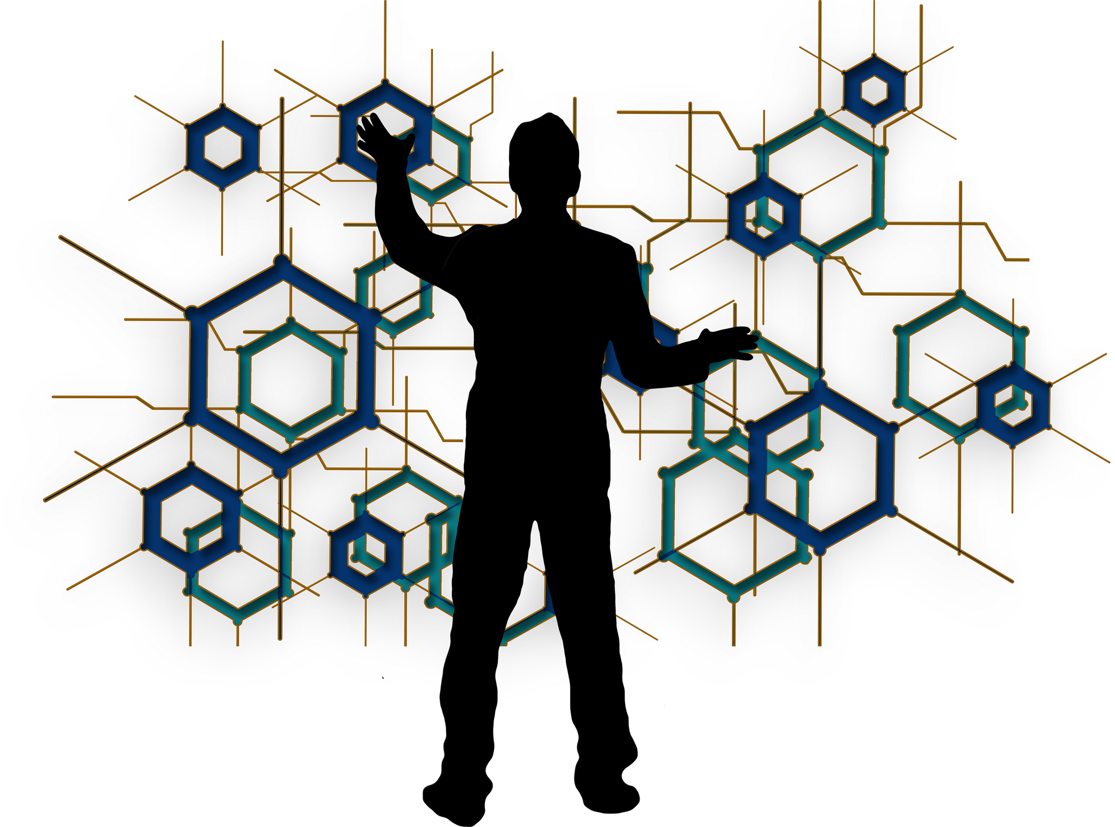
HealChain
Problem Statement &
Requirement Analysis
Identified Problems:
Centralized EHR systems prone to data breaches and interoperability issues.
Lack of patient empowerment in managing data access.
Requirements:
Secure patient-provider authentication
Fine-grained access control using smart contracts
Compliance with healthcare standards (e.g., FHIR, HIPAA)
7

Slide 8
HealChain
Architecture Layers:
User Interface Layer: Developed in React.js
System Design
Application Logic Layer:
Node.js for backend processes and smart contract interactions
& Architecture
Blockchain Layer:
Ethereum network for transaction logging and access control.
Storage Layer:
IPFS for EHR documents
MongoDB for metadata indexing
Storage Layer:
IPFS for EHR documents MongoDB for metadata indexing
8

Slide 9

HealChain
Implementation
Methodology
Development Process:
Requirement gathering and system planning
Frontend and backend module development
Blockchain integration using Ethereum smart contracts
Key Modules:
User Registration: Providers register on the blockchain
Access Control: Patients authorize and revoke provider access
EHR Upload & Retrieval: Smart contracts facilitate secure record management
9

Slide 10
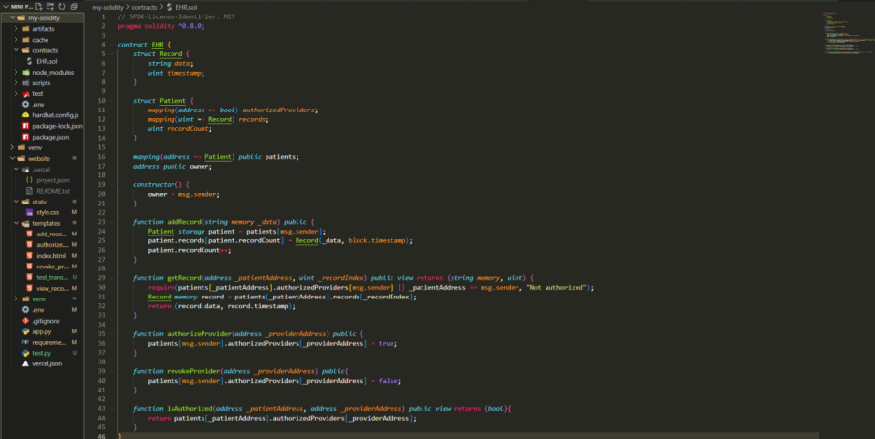
HealChain
Smart Contract
Details
Core Functions:
registerProvider(): Registers a healthcare provider
authorizeProvider(): Grants patient-controlled access
addRecord(): Uploads patient EHR data and stores metadata
Code Highlights: Solidity snippets demonstrating logic for secure transactions
Solidity File for Smart Contracts
10

Slide 11
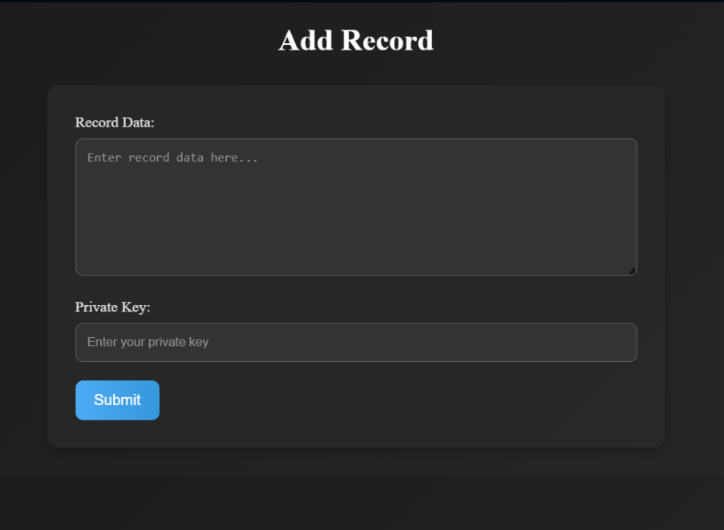
HealChain
Testing &
Test Cases:
T01: Login with valid credentials
T02: EHR upload to IPFS and hash verification
T03: Access request and notification to patient
T04: Access approval workflow (granting and revoking)
Evaluation Metrices:
Transaction throughput
Latency and consensus time
Usability and security assessments
Verification Plan
11
Add Patient’s Record Interface

Slide 12
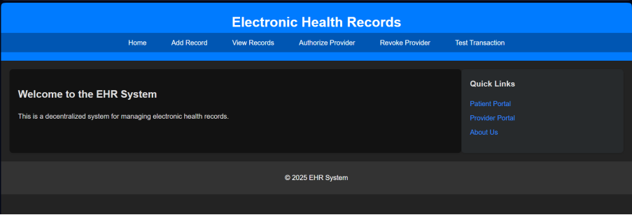
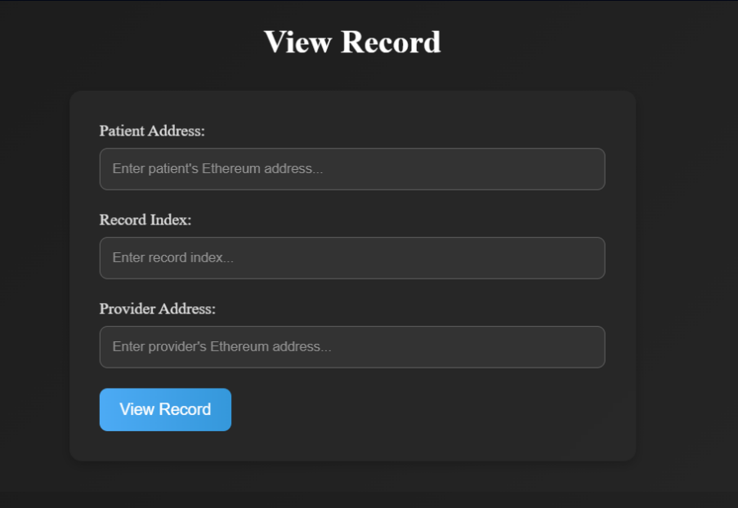
HealChain
Results and
Performance
EHR Website Homepage
KEY OUTCOMES:
Enhanced data security with a 98% reduction in unauthorized access incidents
Transaction latency averaging 1.2 seconds
High patient satisfaction in usability surveys (85%)
PERFORMANCE ANALYSIS:
Comparison with traditional EHR systems
Scalability and efficiency in simulated environments
12
View Patient’s Record Interface

Slide 13
HealChain
Conclusion:
Summary:
HealChain successfully demonstrates the potential of blockchain in revolutionizing EHR systems.
Achieves secure, transparent, and patient-controlled access.
Impact:
Offers a robust alternative to traditional centralized systems, enhancing both security and interoperability.
13

Slide 14


HealChain
Future
SCOPE
Healthcare Challenges:
Fragmented data silos
Centralized control and security breaches
Lack of interoperability
Blockchain Promise:
Decentralized architecture for tamper-proof data
Enhanced patient control over their records
Inspiration: Practical applications like KIIT University’s digitization efforts at KIMS Hospital.
14

Slide 15
HealChain
Individual Contributions
Vivek Kumar: Introduction and system design
Snehil Pandey: Literature review, analysis, report creation, and presentation formatting
Shubham Singh: Technical implementation and smart contract development
Akshay Singh: Methodology and backend integration
Aishwarya Ranjan: Formatting and overall report consistency
Saurav Ranjan: Presentation preparation and project coordination
15

Slide 16

HealChain
“HealChain — Decentralizing Trust in Healthcare Records”
Thank YOU
16

